Slide 1
The Living Constitution

Slide 2
The phrase “Living” documents means putting into use documents written hundreds, even thousands of years ago and justifying their interpretation.

Slide 3
The idea is that a living document should be continuously updated and reinterpreted based on the society and the changes in the cultural norms.

Slide 4
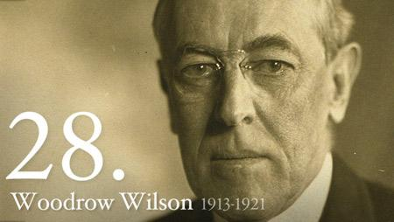
“The Constitution was not made to fit us like a straightjacket. In its elasticity lies its chief greatness.”
President Woodrow Wilson

Slide 5
American Revolution
King of England, colonies,
money, taxation, fought for independence 1776, free from British rule, created new rules and regulations for a stronger gov.

Slide 6
Philadelphia 1787: a meeting of delegates was held to amend the
Articles of Confederation.
These “framers” chose to write an entirely new constitution for the US.

Slide 7
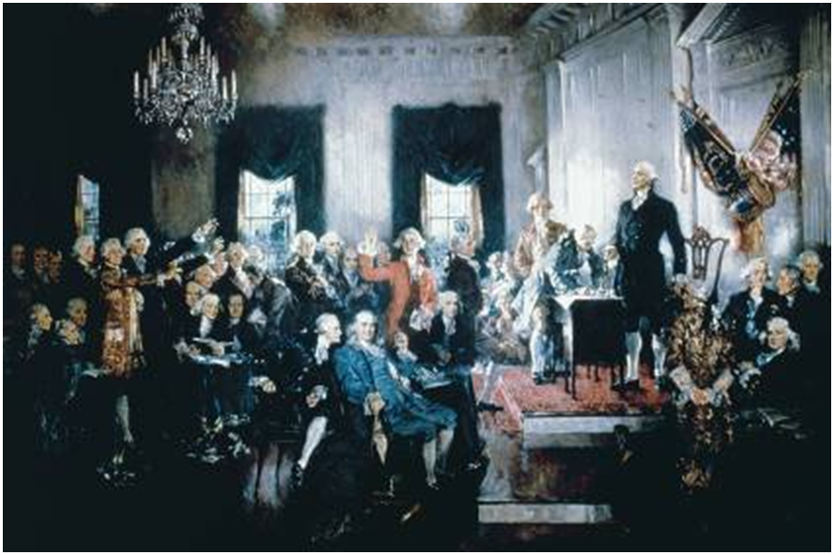
The US Constitution was adopted by the
Constitutional Convention in 1787 as the Ultimate Law of the U.S.

Slide 8
5 Purposes of the Constitution
1. Establish Legitimacy
2. Create Appropriate Structures
3. Describe and Distribute Power
4. Limit Government Powers
5. Allow For Change

Slide 9
1. Establish Legitimacy
Legitimacy – its right to rule
ability to be defended with logic or justification; validity.
The legitimacy had to be based on a contract among those who were to be ruled.

Slide 10
The Preamble to the United States Constitution is a brief introductory statement of the Constitution's fundamental purposes and guiding principles.
Preamble

Slide 11
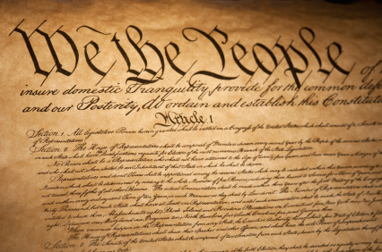
“We the people of the United States….. ___ do ordain and establish this Constitution.”

Slide 12
We the People of the United States, in order to form a more perfect Union, establish Justice,
insure domestic Tranquility,
provide for the common defense,
promote the general Welfare, and
secure the Blessings of Liberty to ourselves and our Posterity,
do ordain and establish this Constitution for the United States of America.

Slide 13
2. Create Appropriate Structures
Based on the principles of a representative democracy.
The framers created Congress, the presidency, and the judiciary to share the powers of the national government.
They also created a system of division of powers between the national government and the state governments.

Slide 14
3. Describe and Distribute Power
The framers created 3 branches:
The Legislative Branch - Congress
The Executive Branch – President
The Judiciary Branch – Supreme Court

Slide 15
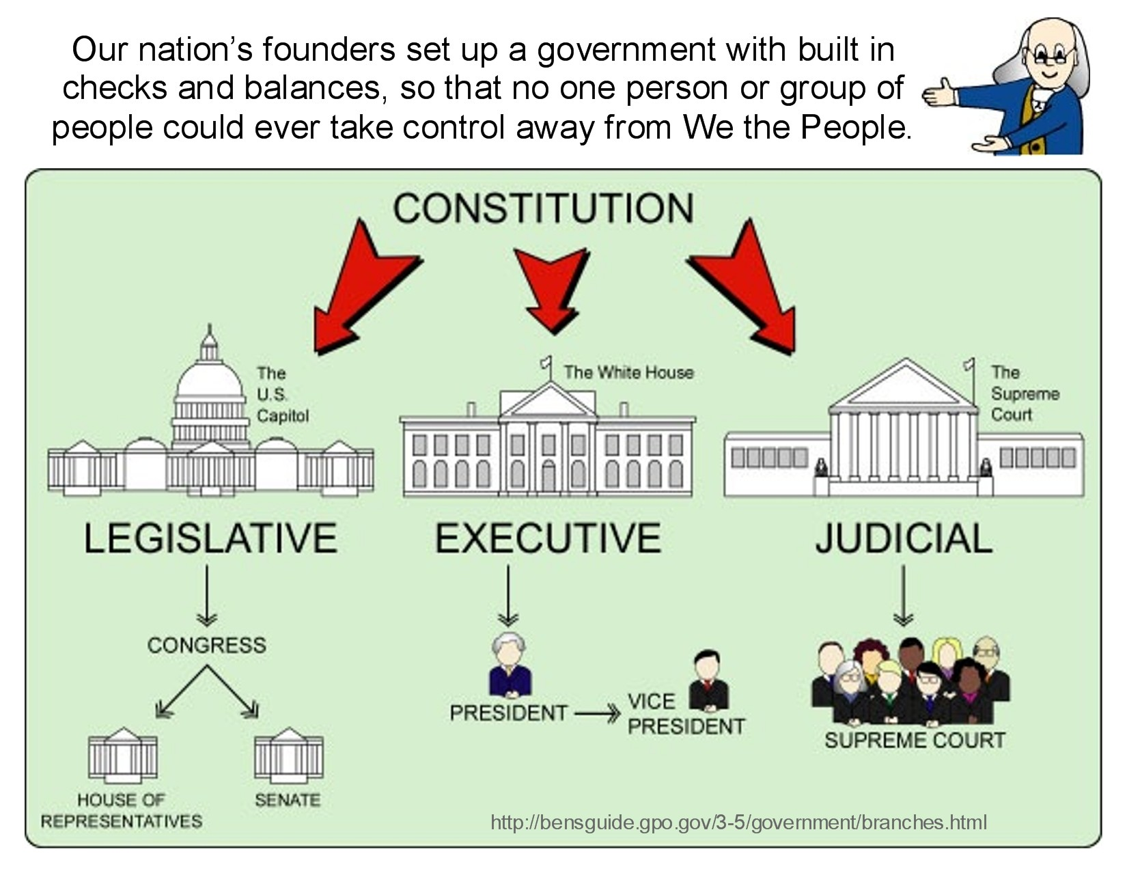

Slide 16
Legislative Branch
Congress
House of Representative - lower house. The number of representatives each state elects is based on that states population. Elected to two year terms.
Senate - upper house - each state has two senators. Equal representation in the senate. Elected to six year terms.

Slide 17
Executive Branch
The President of the United States - Commander and Chief of the Military. Can be elected for 2 terms, each term is 4 years. However, he may serve additional time - how?
Vice President - President of the senate

Slide 18
Supreme Court
There are 9 supreme court justices.
They serve for life! How are supreme court justices chosen?
The supreme court hears cases that are appealed by lower courts. If the supreme court denies an appeal, the previous court decision stands.

Slide 19
4. Limit Government Powers
Limits for Congress’s power.
Limits on the powers of the state governments.
Enumerated functions of the national government.

Slide 20
5. Allow For Change
A means for changing the Constitution in keeping with the times while also maintaining its stability.
The framers created a difficult but not impossible means for amending the constitution.

Slide 21
The Constitution
Article 1: The Legislature sections 1-10
Article 2: The Executive sections 1-4
Article 3: The Judiciary sections 1-3
Article 4: Relations Among States sections 1-4
Article 5: Amending the Constitution
Article 6: Supremacy of the National Government sections 1-3
Article 7: Ratification
The Bill of Rights and Amendments

Slide 22
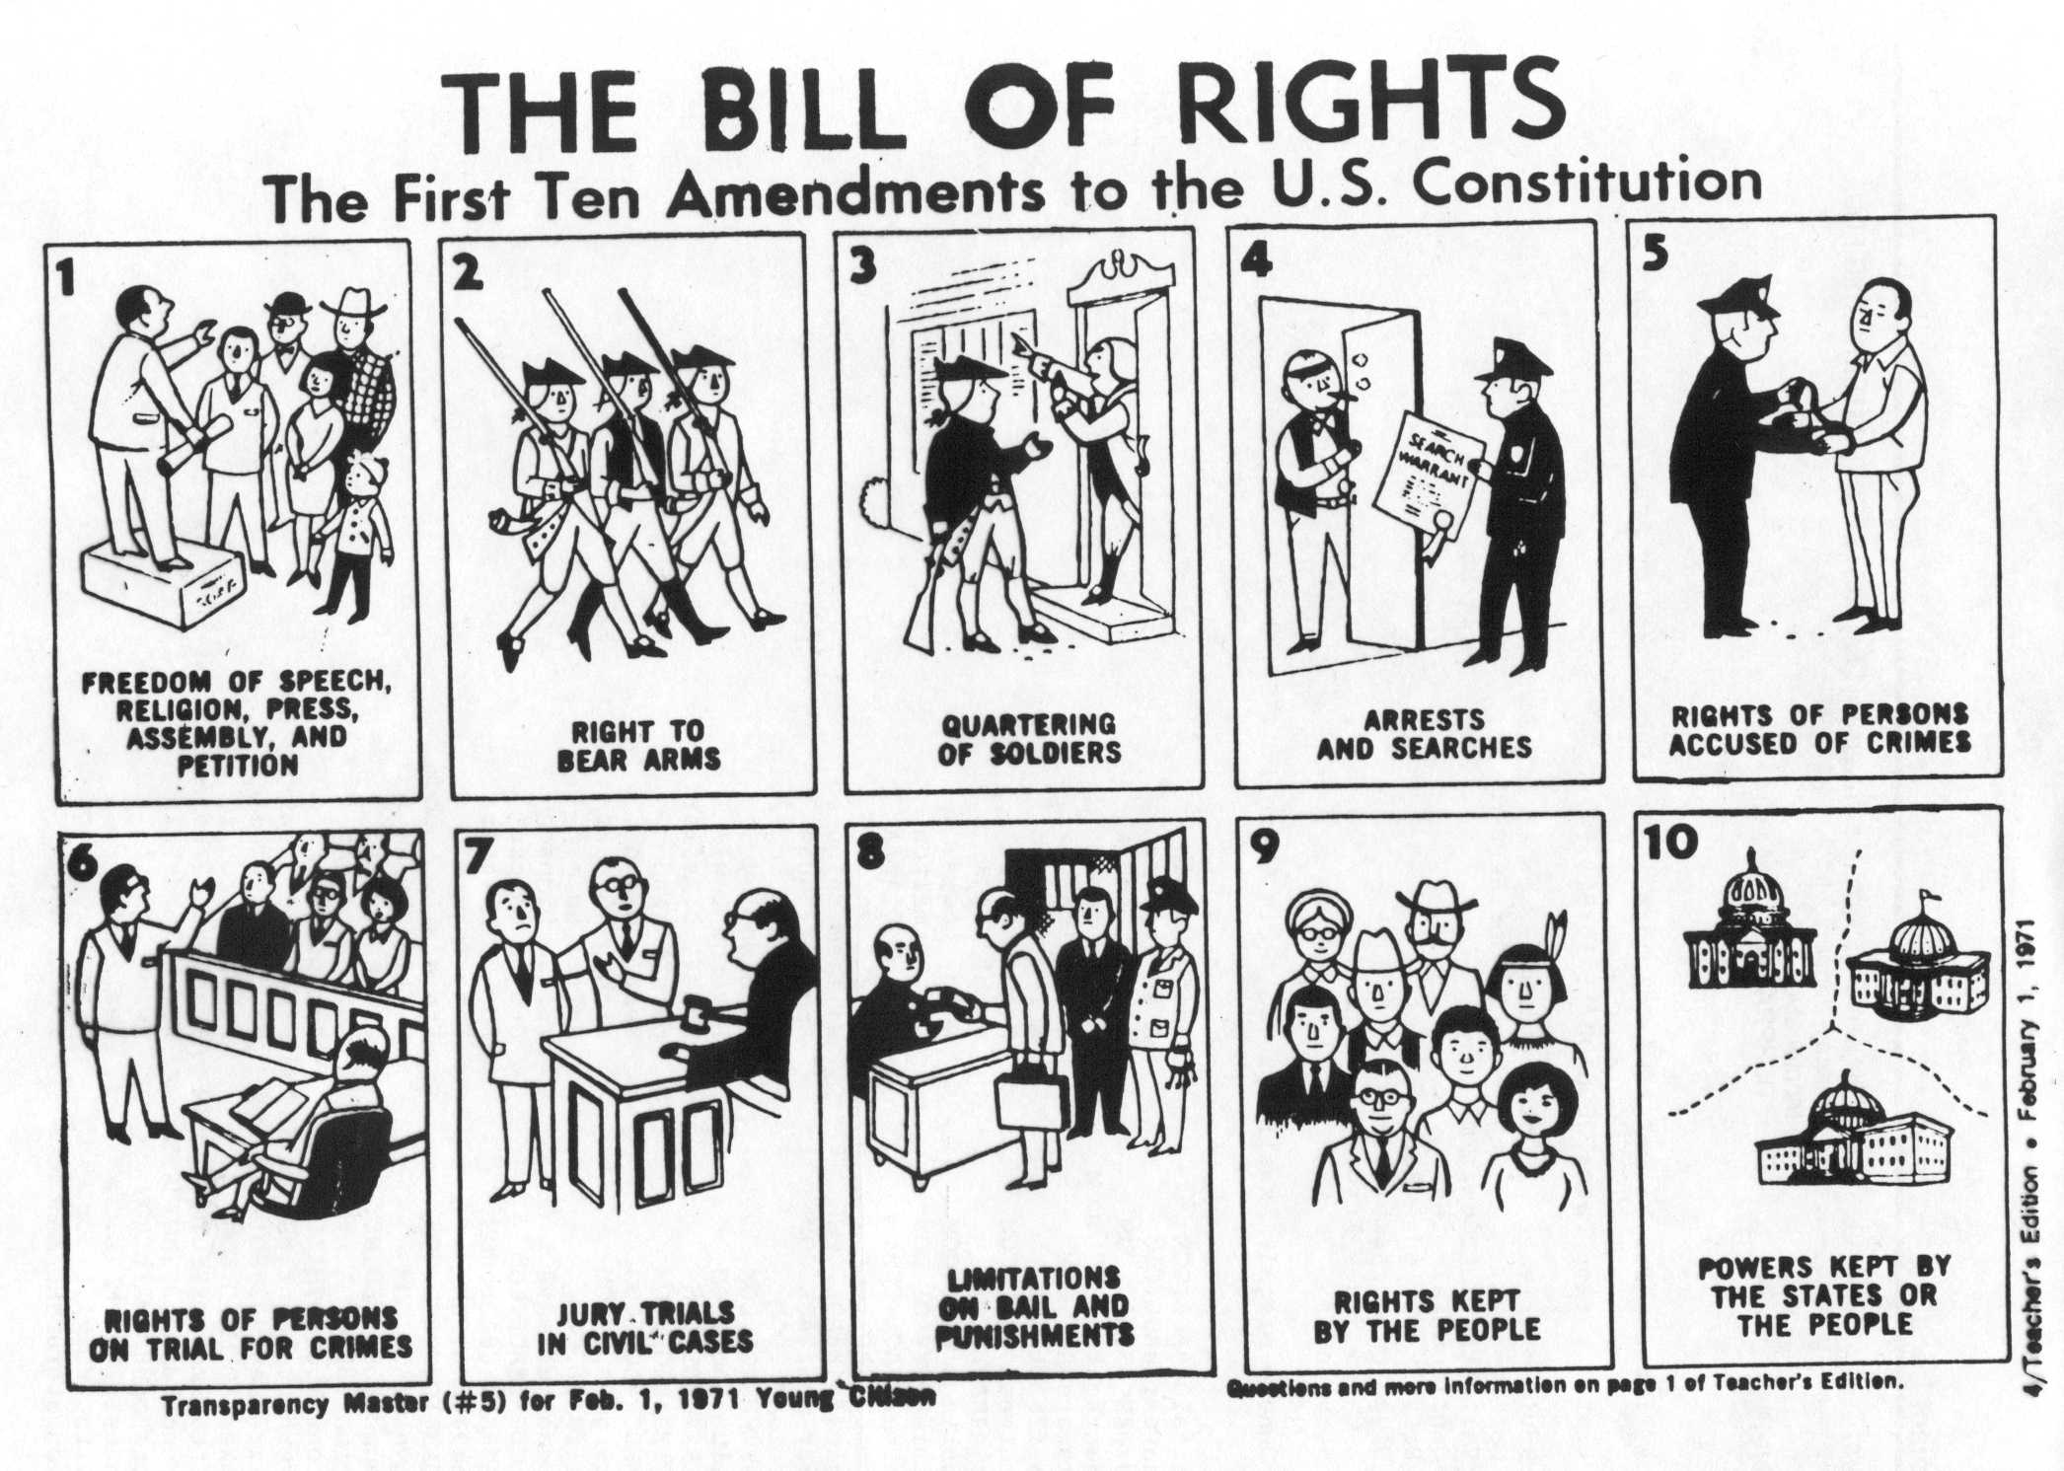

Slide 23
Eminent domain
Federal, state, and local governments may take private property through their power of eminent domain or may regulate it by exercising their Police Power.
For the greater good takes precedence.
The Fifth Amendment to the U.S. Constitution requires the government to provide just compensation to the owner of the private property to be taken.
A variety of property rights are subject to eminent domain, such as air, water, and land rights.

Slide 24
Does the 1st amendment allow complete freedom of speech? – the right to say anything you want at any time, anywhere?
Explain
No there are limits
You may not yell, “FIRE!” in a crowded theater, causing a riot.

Slide 25
What is the newest amendment?
What protection does that amendment give to the American people?
The 27th Amendment
It prevents members of Congress from using taxpayer’s money for their own gain.

Slide 26
Why does the legislative branch of the government represent the people most directly?
What is the principle job of the legislative branch?
House members are elected from congressional districts and senate member from each state
The legislature makes laws

Slide 27
Why are there more members of the House of representatives than the Senate?
The number of representatives is based on population, while each state has two senators only

Slide 28
Name 4 powers Congress has.
To tax, borrow money, regulate commerce, coin money, establish post offices, create federal courts, declare war, raise armed forces, make laws

Slide 29
What powers are denied to Congress?
To the state?
Congress may not: suspend habeas corpus, illegally punish people, levy direct taxes, levy export taxes on goods from any state, show preference among states, take money illegally from the treasury, or confer titles of nobility,
States may not: use any powers listed in Article 1, Section 10 like
Enter into treaties on their own, coin money, illegally imprison people, levy taxes, or engage in war on their own.

Slide 30
What is the main function of the executive branch?
To carry out the laws made by Congress.

Slide 31
Who officially elects the president of the United States?
Explain
The electoral college, by vote of the states’ electors.

Slide 32
How can the president lose his or her job before election time?
If convicted of a crime before election time

Slide 33
How are the Supreme Court justices appointed?
The president nominates them; the senate approves them

Slide 34
What kind of cases go before the Supreme Court?
Why is the Court’s decision whether to hear a case important?
Those appealed from lower courts.
Not to hear a case means that the lower court ruling stands with no further appeal.

Slide 35
To extradite is to send a fugitive back to the state in which he or she is accused of committing a crime.
How is this an example of relations among states?
It exemplifies cooperation among the states

Slide 36
How many states must ratify an amendment for it to become part of the Constitution?
Why do you think it takes that many?
3/4s of the state, or 38 states.
Because it’s serious nature and majority rules

Slide 37
How does Article 6 establish the supremacy of the Constitution?
It makes the Constitution the supreme law of the land.
All laws at every level of government are bound to uphold the Constitution.

